Slide 1


Team Details
  Team name: Ripple Effect
  Team leader name: Victor Chang
  Problem Statement:
  Supplier changes, such as a discontinued part or a jump in copper and freight costs, take days and six teams to trace to products, margins and customers. Manufacturers need that answer, and a plan, before the first meeting.
Notes:
Team Ripple Effect, led by Victor Chang. Problem: one supplier change takes days and six teams to understand; RippleOps answers it in minutes.

Slide 2




Brief about the idea
One supplier notice in, one approved response plan out
RippleOps is an AI change-impact agent for manufacturers. When a supplier discontinues a part, or raw-material and freight costs move, it:
DEMO · NOVACHIP ENDS MCU-X100
12
$4.2M
Traces every level and path of the bill of materials, with BigQuery Graph
affected SKUs in 3 product families
revenue exposed over the next 6 months
Prices cost, margin, revenue at risk and stock coverage, deterministically
58 days
4
Responds with nine Google ADK agents that source alternatives and re-plan production
of MCU-X100 inventory left
products with no approved alternative
Hands off owned actions to every team; a person approves the plan
Fictional seeded dataset · figures asserted by tests
Notes:
RippleOps traces a supplier change through every product, prices the impact, and hands each team an action plan. In the demo, NovaChip ends MCU-X100: 12 SKUs, $4.2M revenue exposed, 58 days of stock, 4 products with no approved alternative.

Slide 3



Opportunities
From days of spreadsheets to one calculated, shared answer
How is it different?
How does it solve the problem?
USP
ERP and PLM store the BOM; they do not trace a change to margin and customers
Chatbots guess numbers; RippleOps calculates them and checks every AI figure
One flow across sourcing, planning and finance, not one team’s view
Gemini reads the notice; BigQuery Graph finds the true quantity per product
Simulates swaps and cost moves, scores suppliers, re-plans 13 weeks
Writes owned, prioritized actions for every team
AI reasons, engines calculate: figures a CFO can sign off on
Nine Google ADK agents, streamed live, with a human approval step
Live end to end on Google Cloud today
WHY NOW
52%
45%
26,225
$210B
of electronic parts discontinued in 2025 had no end-of-life notice
of one year’s profits lost to supply disruptions per decade
supply chain disruption alerts in 2025, up from 22,522
auto revenue lost to the 2021 chip shortage
Z2Data, 2026
McKinsey Global Institute, 2020
Resilinc EventWatch, 2025
AlixPartners, 2021
Notes:
Sources: Z2Data, "Components Are Going EOL Without Product Change Notifications at Alarming Rates" (March 2026). McKinsey Global Institute, "Risk, resilience, and rebalancing in global value chains" (August 2020). Resilinc 2024 disruption release and 2025 annual report. AlixPartners semiconductor shortage forecast (September 2021).

Slide 4






List of features offered by the solution
Eight features, one flow from notice to decision
Notice reader
Multi-level BOM trace
Impact dashboard
Scenario simulator
Gemini turns a PDF, TXT or DOCX supplier notice into a structured event
BigQuery Graph walks every path to the true quantity per product
Affected SKUs, revenue exposure, stock coverage and a Why? panel
Swap parts, move copper and freight, set a margin target
Alternative sourcing
Forecast and re-plan
Nine-agent response
Actions and approval
Suppliers scored 0–100 on six factors behind a sanctions gate
AI.FORECAST (TimesFM) demand and a 13-week OR-Tools re-plan
Google ADK agents run in sequence and in parallel, streamed live
Owned actions per team, each citing its facts; a person approves
Notes:
Every number in these features comes from deterministic engines; Gemini reads, plans, chooses tools and explains. An Ask RippleOps assistant answers questions over the same tools.

Slide 5
Process flow diagram or Use-case diagram
Seven steps from supplier notice to approved plan
1
2
3
4
5
6
7
CHANGE
TRACE
CALCULATE
SOURCE
RE-PLAN
DECIDE
ACT
Gemini reads the supplier notice
BigQuery Graph walks every BOM level
Cost, margin, revenue and stock coverage
Agents vet and score alternate suppliers
TimesFM forecast, OR-Tools re-plan
A planner approves the proposed plan
Owned actions for every team
IN THE DEMO · MCU-X100 END-OF-LIFE
NovaChip ends MCU-X100; last-time buy 30 Jan 2027
12 affected SKUs in 3 product families
$4.2M revenue exposed; 58 days of stock
5 options scored; 1 blocked by sanctions
Bridge buy of 500 units; fill rate 64% → 100%
Plan PLAN-EVT-2001-02 approved
Procurement, engineering, finance and sales
Gemini agents (Google ADK)
Deterministic engines (BigQuery, Python, OR-Tools)
A person
One flow: under two minutes of agent work (18.5 s on the latest live run) turns a supplier notice into a plan a person can approve.
Notes:
Blue steps are driven by Gemini agents that call typed tools; green steps are pure calculation; the decision belongs to a person. The bottom row shows what each step produced in the MCU-X100 demo.

Slide 6
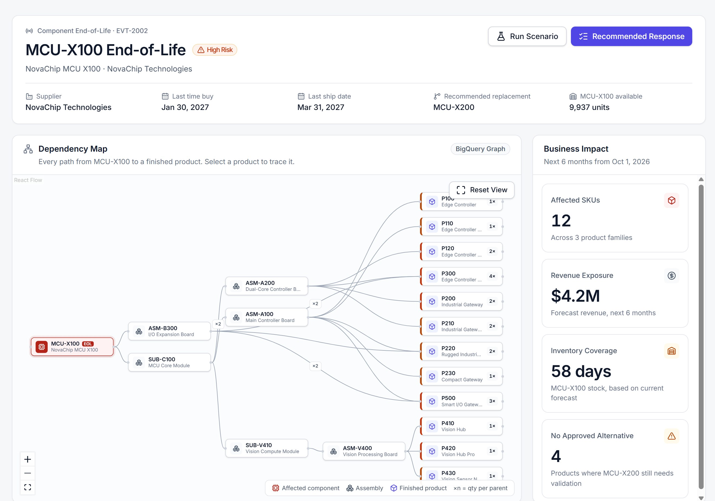
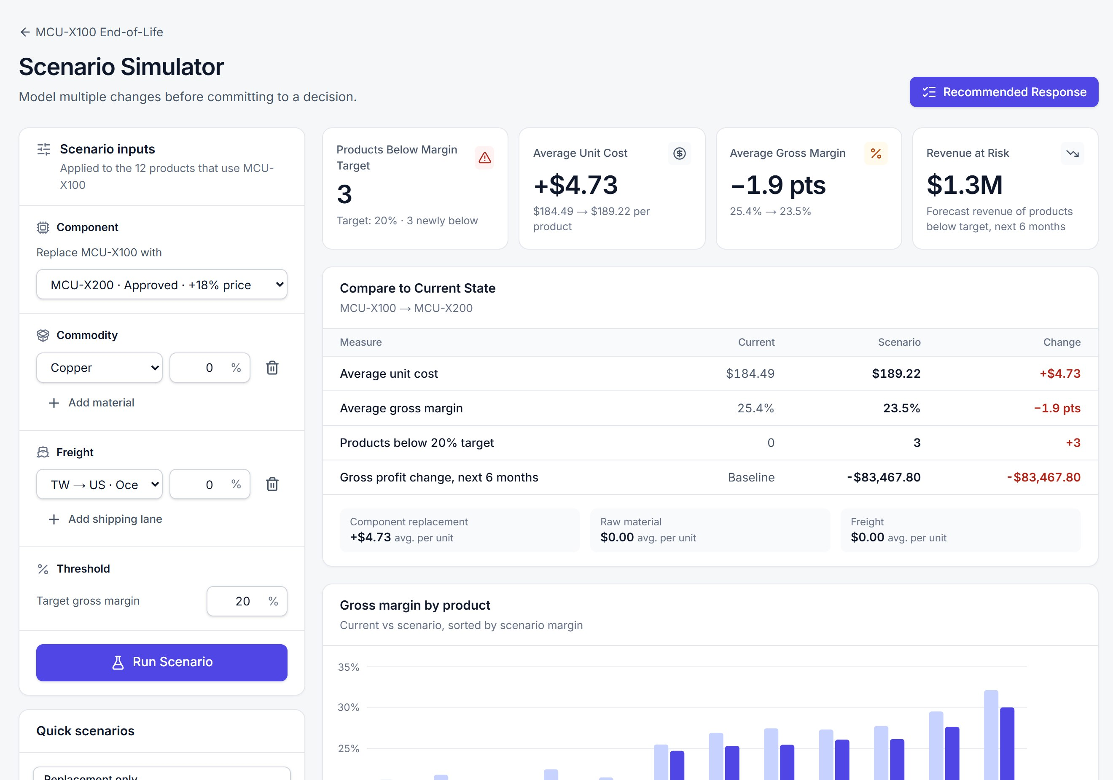
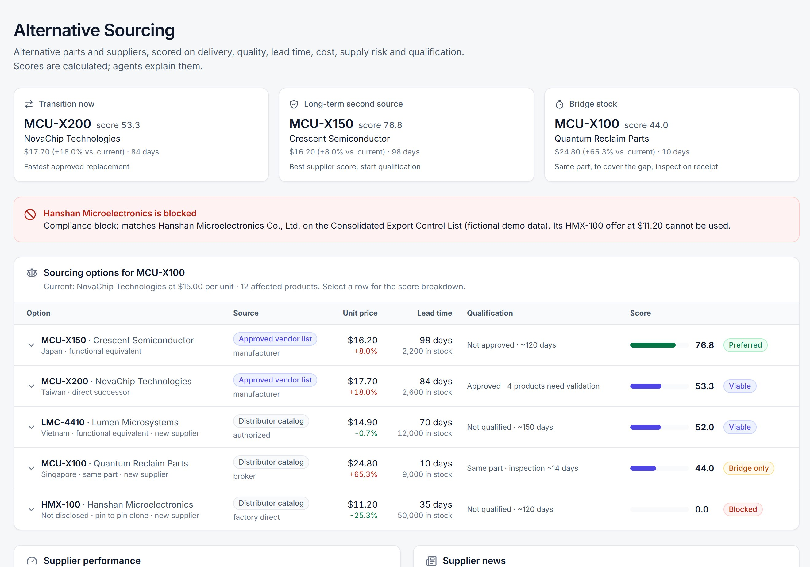
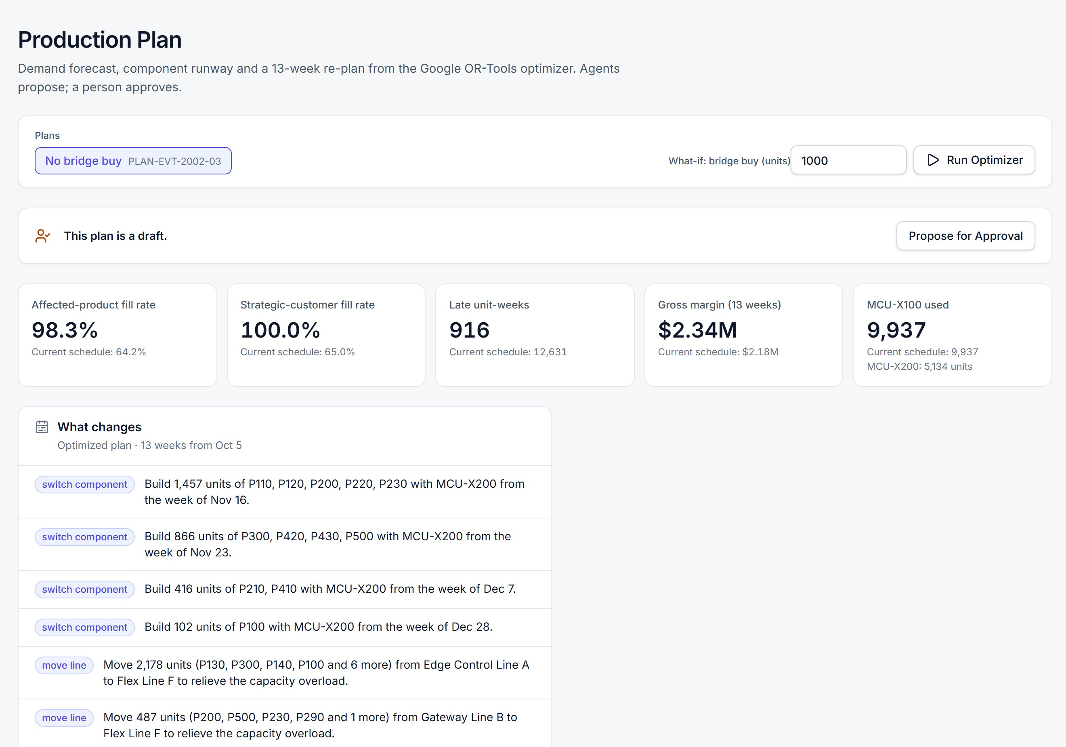
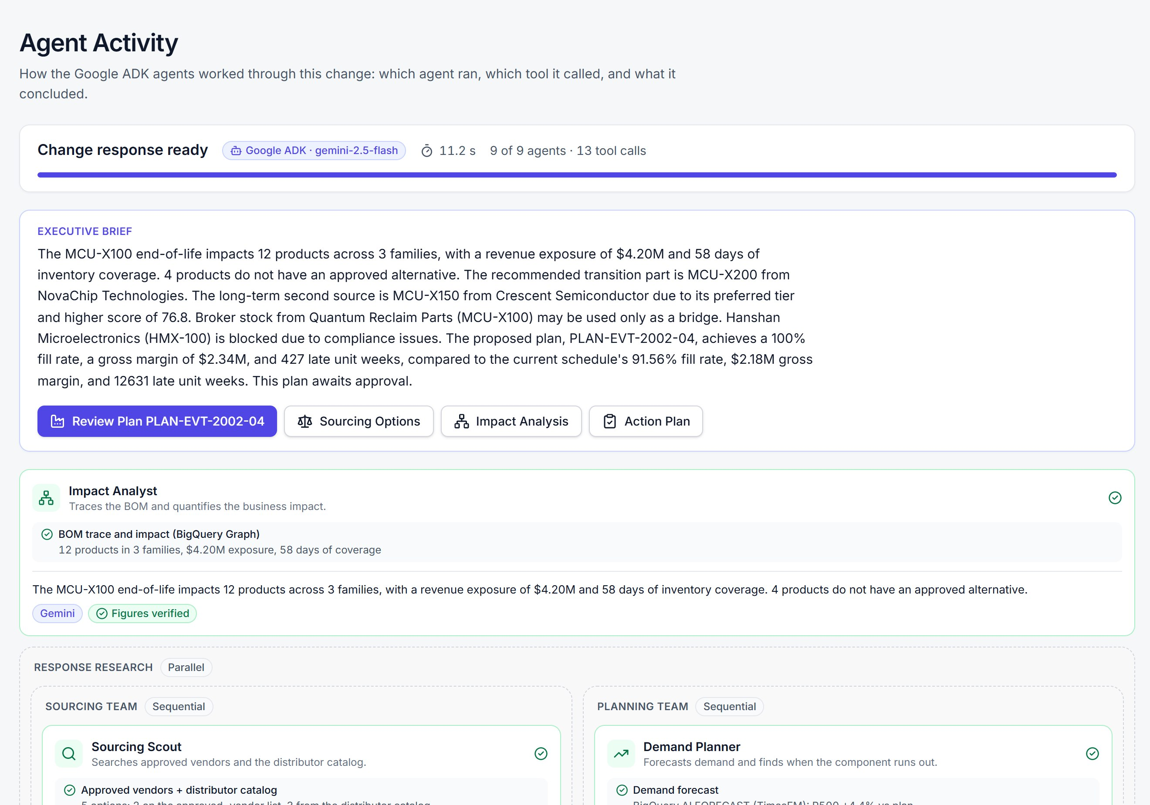
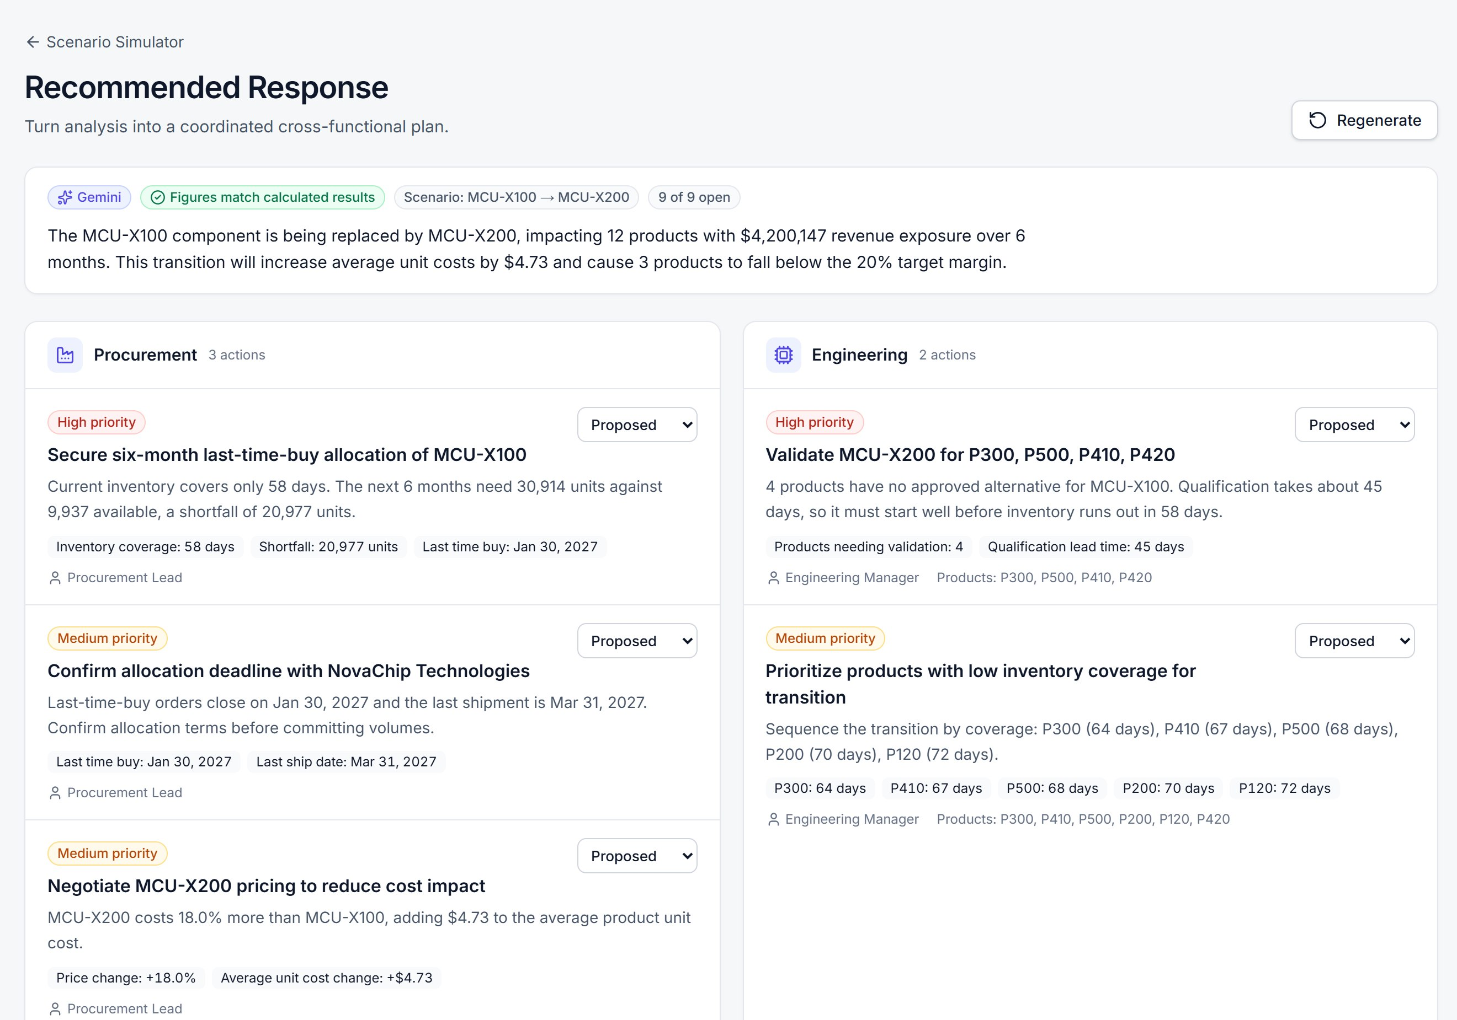
Wireframes/Mock diagrams of the proposed solution (optional)
Six live screens, one case: the planner’s path through RippleOps
1 Impact Analysis the whole ripple
2 Scenario Simulator test a decision
3 Alternative Sourcing suppliers scored
4 Production Plan 13-week re-plan
5 Agent Activity nine agents, live
6 Recommended Response next moves
Notes:
The six main screens of the live prototype, in the order a planner uses them. The Snapshots slides show each screen in detail.

Slide 7
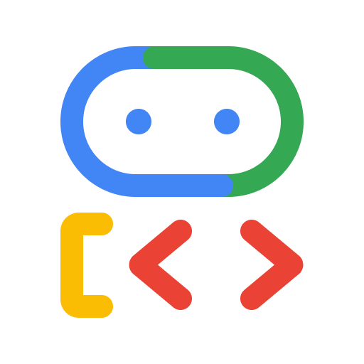





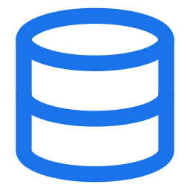
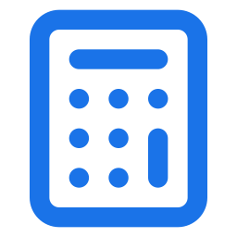


Architecture diagram of the proposed solution
Built end to end on Google Cloud and Google AI
API SERVICE · CLOUD RUN
Gemini 2.5 Flash
Vertex AI · notice extraction, agents, assistant
Google ADK
9-agent workflow · FastAPI · SSE
Google OR-Tools
CP-SAT production re-plan
BigQuery
17 tables · BigQuery Graph (GQL) · AI.FORECAST (TimesFM)
Business teams
Browser
Next.js web app
Cloud Run · /api proxy
Deterministic engines
BOM, cost, scenario, risk, sourcing
Connectors
Catalog, sanctions, news: mock today, API-ready interfaces
Grounding guardrail
Checks every AI number against tool output
Product logos © Google, used to identify Google services. Connectors use fictional fixtures; DigiKey, Mouser, OpenSanctions or a news API plug into the same contract.
Notes:
The browser talks to a Next.js app on Cloud Run, which proxies to a FastAPI service on Cloud Run running the Google ADK agents. Agents call Gemini 2.5 Flash on Vertex AI to reason and call typed tools to calculate: BigQuery holds 17 business tables, BigQuery Graph traces the BOM, AI.FORECAST (TimesFM) forecasts demand, and OR-Tools re-plans production.

Slide 8

Gen AI implementation · Google ADK multi-agent workflow
Nine AI agents work the case, two teams in parallel
RESPONSE RESEARCH · TWO TEAMS IN PARALLEL
Sourcing team · 5 agents
Scout
Finds alternate parts and suppliers
find_sourcing_options
Due diligence, in parallel
Evaluator
Scores each supplier 0–100
score_suppliers
Impact analyst
Traces the BOM and sizes the exposure
analyze_change_impact
Performance auditor · supplier KPIs
Response coordinator
Writes the brief and the action plan
generate_action_plan
Compliance screener · sanctions
Risk-news monitor · supplier news
Planning team · 2 agents
Demand planner
Forecasts with TimesFM; sizes material needs
forecast_demand
Production planner
Re-plans with OR-Tools; proposes a plan
optimize_production_plan
Agents share findings through ADK session state
Every agent and tool step streams live to the UI
The production plan is only proposed; a person approves it
Notes:
SequentialAgent: impact analyst, then a ParallelAgent with the sourcing team (scout, three parallel due-diligence agents, evaluator) and the planning team (demand planner, production planner), then the response coordinator. Gemini 2.5 Flash on Vertex AI. Gemini decides which tools to call; the tools calculate.

Slide 9
Trustworthy by design · AI reasons, engines calculate
Numbers your CFO can sign off on
Gemini via Google ADK: reasons | BigQuery, Python and OR-Tools: calculate
Reads supplier notices into structured events | Multi-level BOM trace with BigQuery Graph
Chooses which tools to call, and in what order | Cost roll-up, gross margin and scenarios
Decides whether a bridge buy is worth testing | Production re-plan with OR-Tools CP-SAT
Explains forecasts, scorecards and plans | Demand forecast with BigQuery AI.FORECAST
Writes findings, the brief and action wording | Supplier scores, compliance gate, risk levels
Grounding guardrail
An ADK after-model callback checks every number an agent writes against tool output. Anything ungrounded falls back to the calculated finding. Without Gemini, the same tools still run in order.
Notes:
Finance and procurement cannot act on a number a language model guessed. Gemini never does business arithmetic; quantities, costs and margins come from deterministic code, and a guardrail checks every figure in AI text.

Slide 10






Technologies to be used in the solution
Google Cloud and Google AI at the core, open source around it
Google AI
Data
Optimization and engines
Gemini 2.5 Flash on Vertex AI
Google ADK 2.9 multi-agent workflow
AI.FORECAST TimesFM in BigQuery
BigQuery 17 business tables
BigQuery Graph GQL BOM trace
Recursive SQL automatic fallback
OR-Tools 9.15 CP-SAT re-plan
Python 3.11 cost, scenario, risk
Grounding check AI numbers vs tools
Backend
Frontend
Cloud and quality
FastAPI REST and server-sent events
Pydantic 2 typed tools and schemas
pypdf notice parsing
Next.js 16, React 19 TypeScript
React Flow dependency map
Recharts, Tailwind 4 charts and UI
Cloud Run web and API services
Cloud Build source deploys
pytest 92 automated tests
Notes:
Google ADK orchestrates nine Gemini agents; BigQuery and BigQuery Graph hold and trace the data; OR-Tools optimizes; everything is deployed on Cloud Run. Versions are the ones pinned in the repository.

Slide 11
Estimated implementation cost (optional)
A one-site pilot runs for roughly $50–120 a month
Component | Sizing | Est. / month
Cloud Run · API | 1 vCPU, 2 GiB, 1 warm instance | $20–60
Cloud Run · web | 1 vCPU, 512 MiB, scales to zero | < $5
BigQuery storage and queries | 17 tables, MB-scale data | < $5
BigQuery Graph slots | Enterprise, baseline 0, autoscale ≤ 50 | $10–30
Gemini 2.5 Flash | ~200 change events, 9 agents each | $10–20
Total, one-site pilot |  | ≈ $50–120
≈ $0.10–0.25
per change event analyzed
Gemini tokens for nine agents plus BigQuery Graph slot time
$0
idle BigQuery slot cost
Reservation baseline is 0 slots; it bills only while queries run
$0
Estimates from Google Cloud list prices (us-central1) and the current deployment’s sizing, not a quote. Validate with the Google Cloud Pricing Calculator.
software licences
ADK, OR-Tools, FastAPI and Next.js are open source
Notes:
Assumptions: one site, about 200 change events a month, the current Cloud Run sizing (API 1 vCPU / 2 GiB with one warm instance; web scales to zero) and a BigQuery Enterprise reservation with a 0-slot baseline. These are estimates, not quotes.

Slide 12
Snapshots of the prototype
Live on Google Cloud · fictional demo data
See the whole ripple, then test a decision
Impact Analysis
BigQuery Graph traces every path from MCU-X100 to 12 products
Scenario Simulator
MCU-X200: +$4.73 unit cost, −1.9 pts margin, 3 below target
Notes:
Screens from the live deployment on Cloud Run, using the fictional MCU-X100 dataset.

Slide 13
Snapshots of the prototype
Live on Google Cloud · fictional demo data
Find the next supplier, then re-plan the line
Alternative Sourcing
Five options scored 0–100; one blocked by a sanctions match
Production Plan
OR-Tools re-plans 13 weeks; the plan waits for a person
Notes:
Screens from the live deployment on Cloud Run, using the fictional MCU-X100 dataset.

Slide 14
Snapshots of the prototype
Live on Google Cloud · fictional demo data
Nine agents brief every team on its next move
Agent Activity
9 of 9 ADK agents finished; executive brief with verified figures
Recommended Response
Prioritized actions per team, each citing its facts
Notes:
Screens from the live deployment on Cloud Run, using the fictional MCU-X100 dataset.

Slide 15
Prototype Performance report/Benchmarking
Fast enough for a live meeting, verified by 92 tests
18.5 s
13
Full nine-agent run
Latest live run on Gemini 2.5 Flash; 13–94 s observed
Tool calls per run
56 agent and tool steps streamed live to the UI
< 0.3 s
92 / 92
Median API response
Impact, sourcing and actions on Cloud Run
Automated tests pass
Unit, integration and API tests, in 15 s
Accuracy: demo figures (12 SKUs, $4.2M, 58 days, +$4.73, −1.9 pts) are asserted in CI; the BigQuery Graph trace matches recursive SQL and the seed.
Notes:
Measured on 13 October 2026 against the live Cloud Run deployment (five GET requests per endpoint, cached analysis). The production plan endpoint includes the OR-Tools comparison. Agent run time depends on Gemini latency: 13 to 94 seconds observed, 18.5 seconds on the latest run. 92 backend tests pass locally in about 15 seconds.

Slide 16



Additional Details/Future Development (if any)
From prototype to an always-on supply chain co-pilot
NEXT
THEN
LATER
Connect
Act
Watch
ERP and PLM connectors for BOMs, stock and orders
Real catalog, sanctions and news APIs on today’s interfaces
Single sign-on and role-based access
Write approved actions back to ERP and ticketing
Approval workflow and audit trail for every decision
Notify owners by e-mail or chat
Continuous monitoring of supplier feeds
Tariff, commodity, freight and supplier-failure triggers
Multi-plant, multi-region BOMs at BigQuery scale
Same agents and engines everywhere: electronics, automotive, industrial equipment and medical devices; only the data and connectors change.
Notes:
The connectors are interfaces today, so real APIs plug in without changing the agents. The same loop covers tariffs, commodity spikes, freight disruption and supplier failure.

Slide 17



Provide links to your:
Try RippleOps live, read the code, watch the demo
GitHub Public Repository
github.com/victorchangwork052/rippleops
Try the live demo
1
Open the product link
Demo Video Link (3 Minutes)
https://drive.google.com/file/d/1c1dxjsODO5XLfD-MqT9WZJLhYdOSqMGH/view?usp=sharing
2
Select Load Demo Scenario
3
Select Analyze Impact to start the nine-agent run
Final Product Link
rippleops-web-273776274235.us-central1.run.app
All demo data is fictional
Notes:
Shortcut: /demo/mcu-x100 loads the demo scenario in one step. The app also runs locally without Google Cloud credentials.

Slide 18

Notes:
Thank you. RippleOps: one change, every impact, one decision.

